Slide 1

K. S. R. College of Engineering (Autonomous) Affiliated to Anna University, Chennai & Approved by AICTE, Delhi Accredited by NAAC with ‘A’ Grade and Accredited by NBA K.S.R. Kalvi Nagar, Tiruchengode – 637215, Namakkal Dt. Tamilnadu.
B. E. - Computer Science and Engineering
First Review on 20.04.2021
Project Title
ONLINE POLLING SYSTEM
Davanika R

Slide 2
ABSTRACT
In “ONLINE POLLING SYSTEM” a voter can use his/her voting right online without any difficulty. In this system the voter do not have to go to the polling booth to cast their vote.They can use their personal computer to cast their votes through voter ID.Our paper deals with online polling system that facilities user(voter), candidates and administrators to participate in online voting.
Our online polling system is highly secured because of face detection, fingerprint etc... And it has a simple and interactive user interface. He/she has to be registered first for him/her to vote. Enter all your personal details on the website for ”NATIONAL VOTERS SERVICE PORTAL” Such as your name, date of birth, age, constituency of residence from where you have been registered as aa voter and search as your name in search electoral in the voter list of your state.
This service is provided by the election commission of india. Users can search their name by selection their state name. Details such aa first name, last name, assembly constituency name, gender etc... Are also required to perform the search. District-wide search option is also available.
After registration the voter assigned a secret voter ID with which he/she can use to login into the system and enjoy service provided by the system.

Slide 3
BRIEF OVERVIEW OF THE TECHNOLOGY
Front end:
JavaScript
HTML
CSS
Bootstrap
Back end:
PHP
MySQL
Software Requirement:
WAMP Server

Slide 4
EXISTING SYSTEM AND IT’S DISADVANTAGE
The Existing system of Election is running manually. The voter has to visit to booths to vote a candidate.
The voter has to manually register into the voter list also vote counting has to be done manually.
All the information of the voter are candidate is to be filling in manually. Voter must be present in his/her constituency to give his/her vote.
The voting system previously being used by the government is a paper based system
Some of the existing systems are
1.Paper-based voting
2.Direct recording electronic voting machine
3.Punch card
Disadvantage
Wastage of time
There are Electronic voting machines used which are more costly.

Slide 5
OBJECTIVES OF PROPOSED SYSTEM
The main objective of online polling system is to use advanced computer technology.
It can be used for the Indians who are working in foreign countries and for the government employees of election department.
It can also be used for the physically challenged persons,aged
person’s and the patients who cannot come to the voting booth.
The objective is to vote in a place where we are simply with the help of online services.
By this process we could attain 100% voting in our country.

Slide 6
ADVANTAGES OF PROPOSED SYSTEM
Fast and easy way of conducting election.
To increase the voting percentage.
Admin can verify the documents and details of candidate.
System generated Unique ID and password gives more secure logins.
To make voter easy to vote from anywhere.

Slide 7
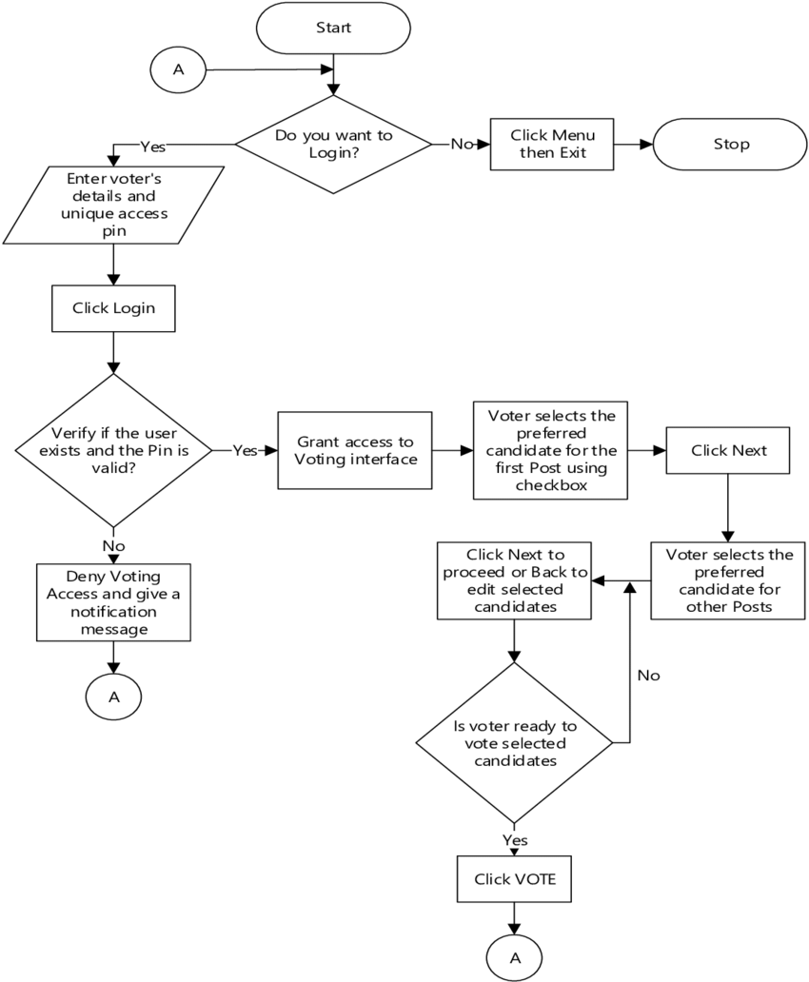
SYSTEM ARCHITECTURE/MODULE DIAGRAM

Slide 8
MODULE DESCRIPTION
Login
Voter details
Polling
Report generation
Admin module

Slide 9
Login:
It is the login session for the administrator voter and exit.
Voter details:
It is used to view voter details from database.
Polling:
It is used to poll vote to candidates during election.
Report generation:
Its is used to get election results and also reset database after all process is completed
Admin module:
Admin checks the data and the valid voter.
Admin also gives the result once the voting is conducted. Only admin is authorized to check the result.

Slide 10
REFERENCE
https://www.nvsp.in
https://voterportal.eci.gov.in
Electoralsearch.in

Slide 11
Queries

Slide 12
Thank you

